Slide 1
PROJECT TITLE
PIP104 PROFESSIONAL PRACTICE-II
Final Review
Batch Number:
Roll Number | Student Name
20201CSE0902 | SAHANA GOWDA KR
20201CSE0886 | BHAVANA V
20201CSE0873 | ANKITHA MORE B
20201CSE0876 | POOJITHA G
20201CSE0858 | G M VINAY SREEKAR REDDY
Under the Supervision of,
Dr. Prasad P S
Assistant Professor
School of Computer Science Engineering & Information Science
Presidency University

Slide 2
Introduction
The inputs and products of commodities production, as well as the day-to-day lives of people, are significantly impacted by changes in the prices of commodities.
Consequently, in order for production authorities to make informed judgments, a trustworthy commodity price forecast is necessary. The capacity to forecast expenses is necessary.
The poor's standard of living decreases in the commodity prices rise, and vice versa when commodity prices decline, particularly in emerging nations.
However, the people who put their labor into creating these goods will be affected by changes in price.
This research looks into how the production output is affected by high and low commodity prices using a computational general equilibrium method.
This paper presents a novel approach to model selection that takes time series flexibility into account.

Slide 3
Literature Review
Year | Author Name | Title | Methodology | Advantages | Disadvantages
2020 | Zhang, H., Sun, D., & Wang, Z. | Forecasting Commodity Prices with Time-Varying Attention Weights | Attention Mechanism, Deep Learning | Captures Time-Varying Relationships, Improves Forecasting Performance | Complexity, Data Dependency
2019 | Robert Garcia Maria Sanchez | Factor Model-Based Forecasting of Commodity Prices Using a Bayesian Approach. | Factor model-based forecasting using a Bayesian approach. | Can identify common factors that drive the prices of different commodities. | Can be sensitive to the choice of factors.
2023 | Khan, M.A., Ahmed, S.A., & Khan, M.I. | A Novel Deep Learning-Based Ensemble Model for Commodity Price Forecasting | Deep Learning, Ensemble Learning | Captures Complex Non-Linear Relationships, Improves Forecasting Accuracy | Complexity, Data Dependency

Slide 4
Literature Review
Year | Author Name | Title | Methodology | Advantages | Disadvantages
2021 | Chen, K., Zhang, L., & Wang, J. | A Transfer Learning Approach for Forecasting Commodity Prices with Domain Adaptation | Transfer Learning, Machine Learning | Reduces Training Time, Enhances Forecasting Performance | Domain Adaptation Challenges, Data Dependency
2021 | Liu, J., Chen, Y., & Zhang, X. | A Temporal Attention Mechanism-Based Recurrent Neural Network for Forecasting Commodity Prices | Recurrent Neural Networks (RNNs), Attention Mechanism | Captures Long-Range Temporal Dependencies, Handles Dynamic Attention Weights | Limited Explainability Data Dependency
2023 | Li, X., Zhang, X., & Chen, Y. | A Novel Ensemble Model for Forecasting Commodity Prices | Ensemble Learning, Machine Learning | Improved Forecasting Accuracy, Reduced Overfitting | Complexity, Computational Cost

Slide 5
Research Gaps Identified
Despite being extremely important for businesses and politicians, commodity price forecasting is still mostly unknown because of the following research gaps
Data limitations
Model deficiencies
Uncertainty and risk assessment
Commodity-specific challenges
Bridging these research gaps requires collaboration across academia, industry, and policymakers. By harnessing advanced data sources, crafting adaptable models, and embracing a holistic perspective.
we can chart a course towards more accurate, reliable, and sustainable commodity price forecasting. Only then can we navigate the foggy seas of tomorrow with informed decisions and a resilient ship, prepared to weather any storm the market throws our way.

Slide 6
Proposed Methodology
The machine learning model will involve experimenting with various algorithms, fine-tuning parameters, and comparing their performance to identify the most effective approach for classifying commodity price data.
This iterative process enables continuous improvement and optimization of the model, ensuring its reliability in capturing diverse trends and patterns in the financial market. Ultimately, the goal is to deploy a robust machine learning model capable of automatically categorizing commodity price data, providing a valuable tool for monitoring and understanding market trends.
This approach offers a scalable and efficient solution to navigate the complexities of analyzing large volumes of financial data in real-time, contributing to more effective decision-making and interpretation of market dynamics.

Slide 7
Objectives
This research introduces an innovative approach to accurately forecasting the future price of commodities.
The objective of this research is to examine different types of movements and interpret the corresponding forecasts. The precise prediction of commodity prices has considerable significance within the domains of economic and financial markets.
As a result, predicting cognitive capacity through the use of models is critical for the goal of price prediction. This paper presents a unique hypothesis based on a large dataset of daily commodity prices over a substantial time period.
The study employs a genetic algorithm regularization strategy inside an online extreme learning machine framework to forecast commodity price data obtained from publicly accessible websites.

Slide 8
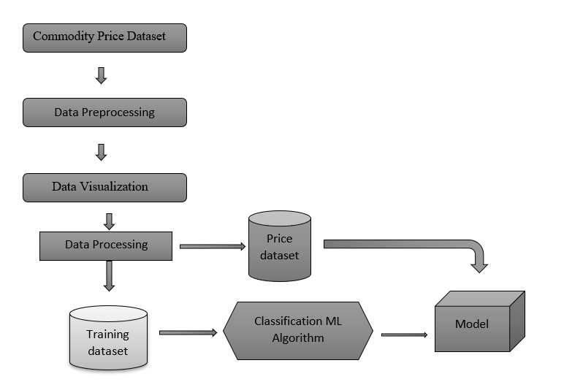
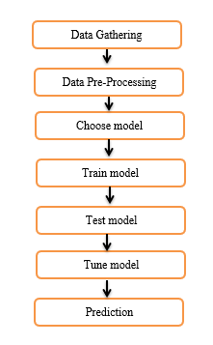
System Design & Implementation

Slide 9
Outcomes
Improved decision-making: Accurate forecasts can help businesses optimize their supply chains, manage inventory levels, and hedge against price fluctuations, leading to increased profitability and reduced risk.
Strategic planning: Long-term price predictions can inform investment decisions, market expansion strategies, and product development initiatives, enabling businesses to adapt to changing market trends.
Enhanced market resilience: Understanding potential price volatility allows businesses to prepare for unforeseen disruptions and shocks, minimizing their impact on operations and finances.
Risk mitigation and preparedness: Early warning of potential price shocks allows governments to implement appropriate measures to mitigate their impact on vulnerable populations and stabilize the economy

Slide 10
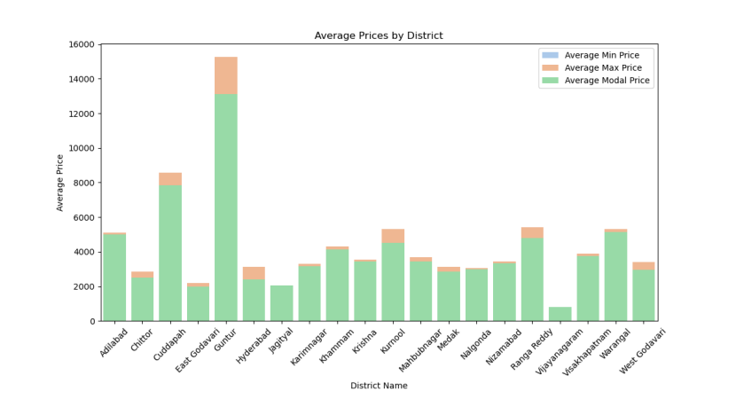
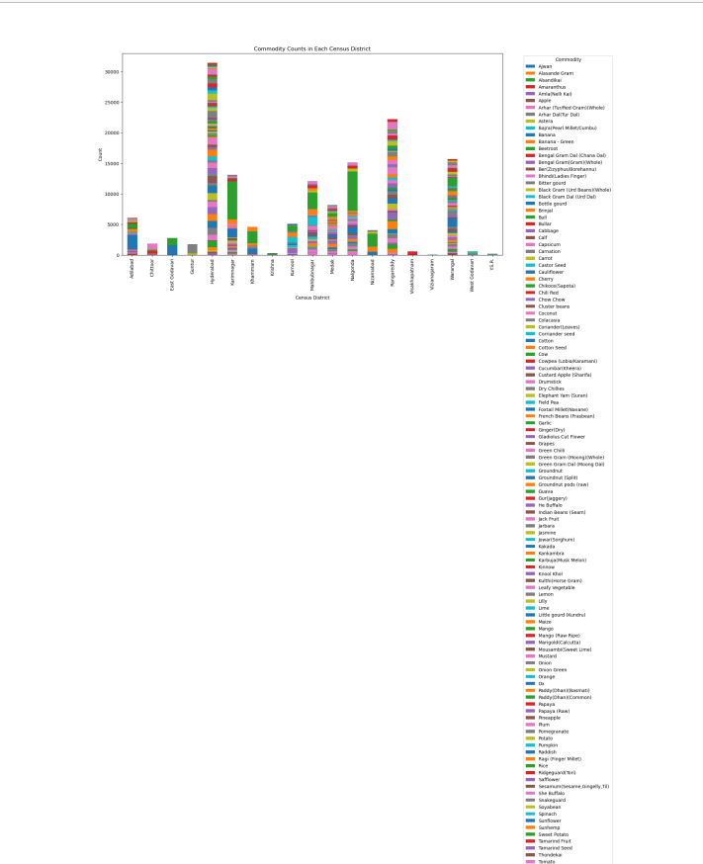
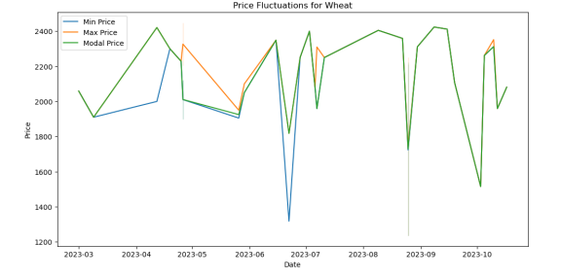
Results

Slide 11
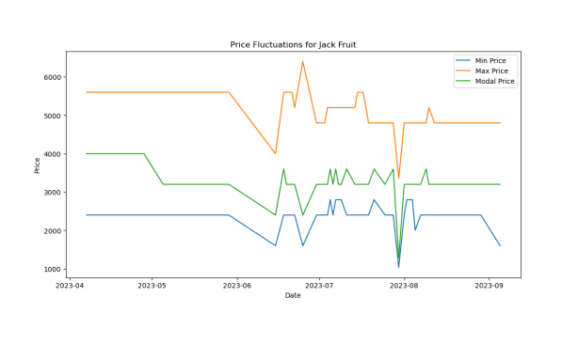
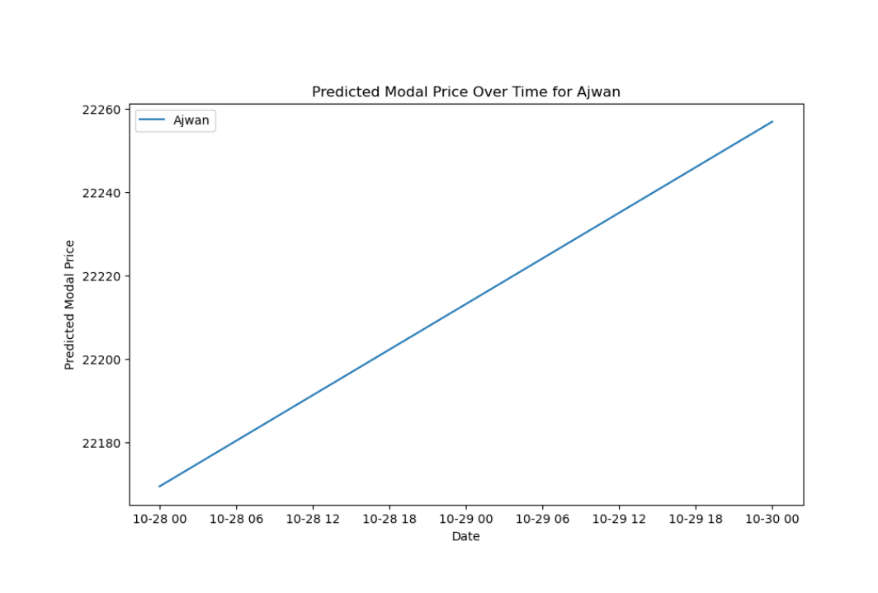
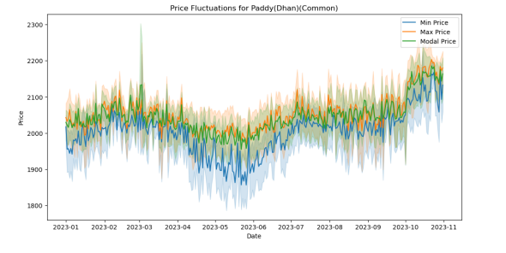
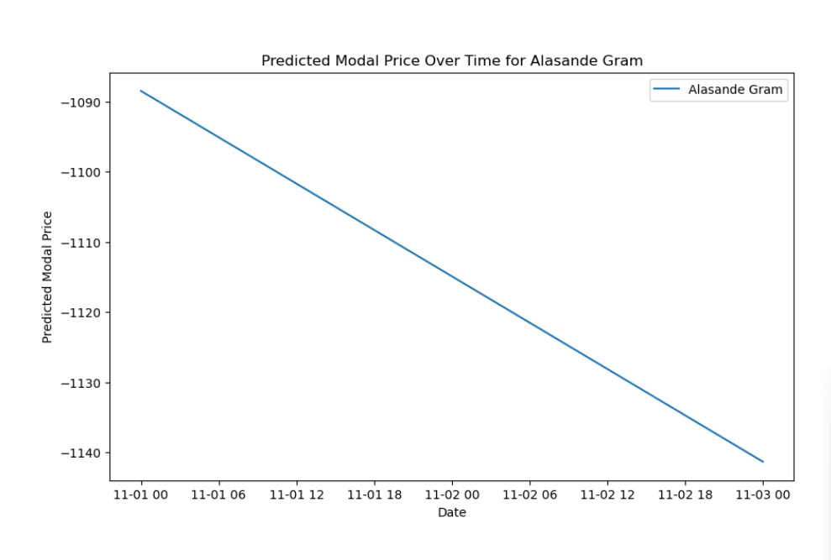
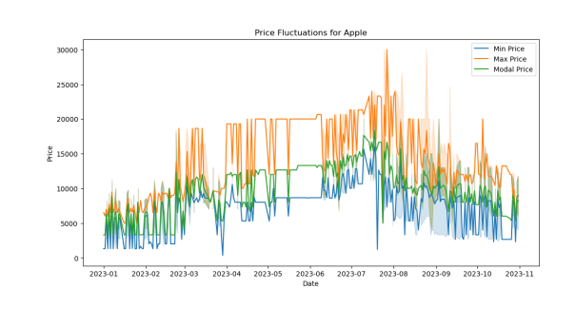
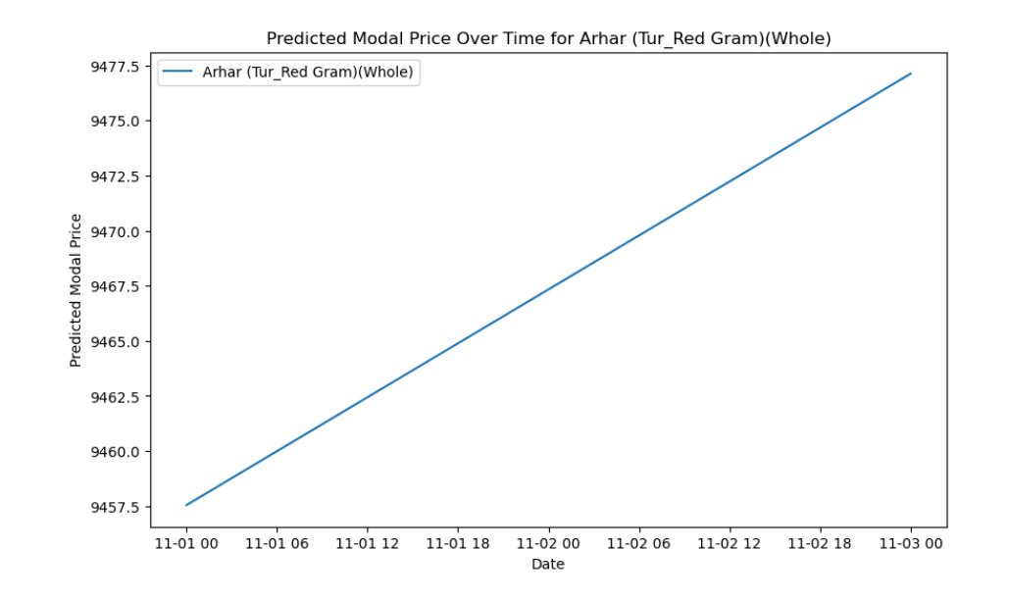

Slide 12
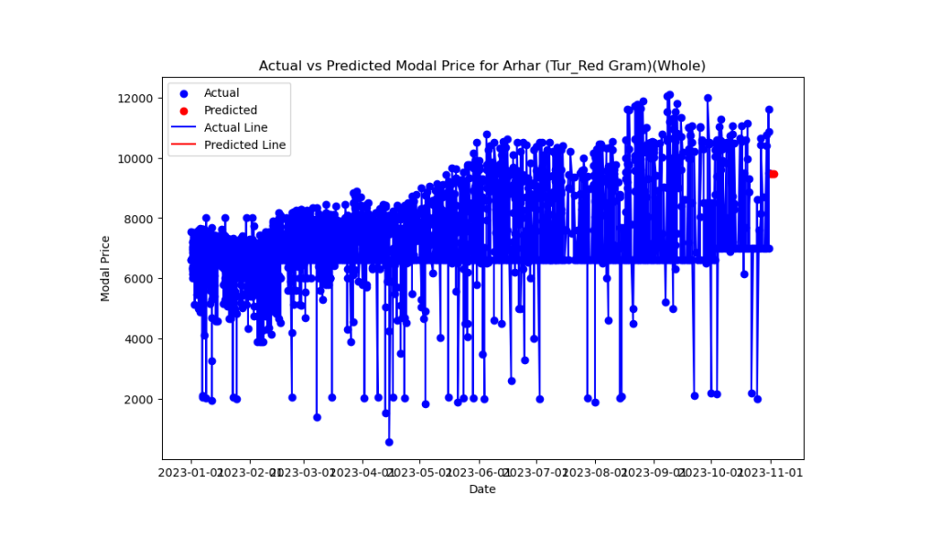
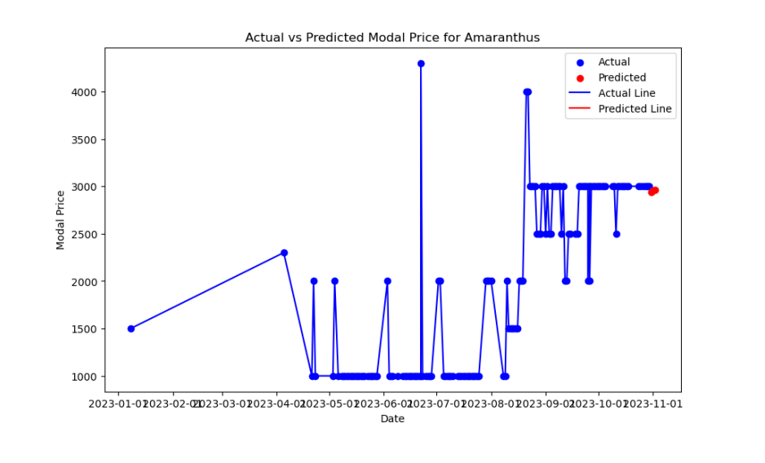
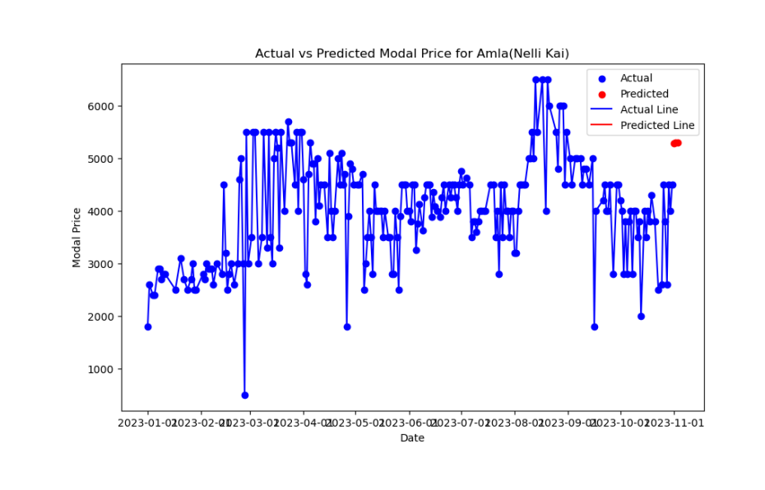
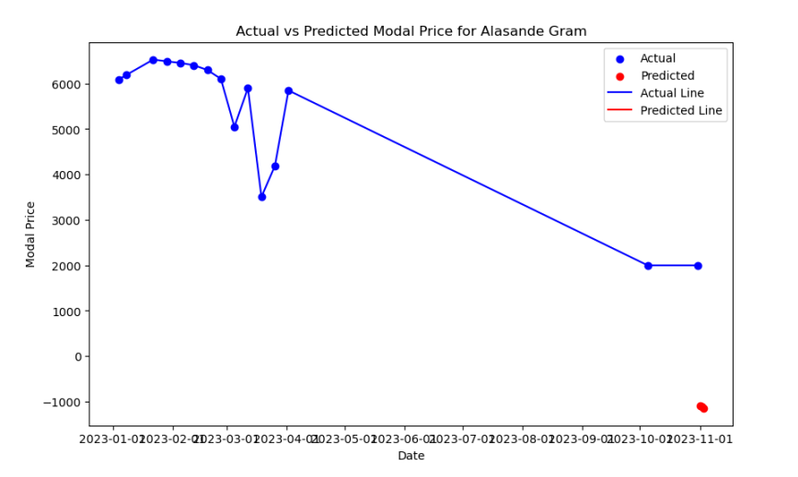

Slide 13
Conclusion
Commodity price forecasting is a vital dance with uncertainty, but it's not divination. Despite our progress, there are still blind areas.
Our models are challenged by complicated interdependencies, whispers from real-time data, and murmurs from black swans. The way ahead?
Accept sophisticated data, create models that are agile enough to deal with non-linearity, and measure that elusive fuzziness that is always there.
Examine each commodity in detail, paying attention to its distinct rhythms and sustainability hints. This is about creating a vivid, dynamic picture of the future market, not just about putting a figure on it.
We can manage uncertainty, make well-informed choices, and eventually create a more durable, sustainable dance floor for the world commodity market by filling in these research gaps.

Slide 14
References
Madaan, L., Sharma, A., Khandelwal, P., Goel, S., Singla, P., Seth, A. (2019). Price forecasting & anomaly detection for agricultural commodities in India. In COMPASS 2019 - Proceedings of the 2019 Conference on Computing and Sustainable Societies (pp. 52– 64). Association for Computing Machinery, Inc.
Chen, Q., Lin, X., Zhong, Y. & Xie, Z. (2019) Price prediction of agricultural products based on wavelet analysis-lstm. In Proceedings - 2019 IEEE Intl Conf on Parallel and Distributed Processing with Applications, Big Data and Cloud Computing, Sustainable Computing and Communications, Social Computing and Networking, ISPA/BDCloud/SustainCom/SocialCom 2019. Institute of Electrical and Electronics Engineers, Inc.
Murkute, Amod, and Tanuja Sarode. (2015) “Forecasting market price of stock using artificial neural network.” International Journal of Computer Applications 124 (12) : 11-15.
Liaw, Andy, and Matthew Wiener. (2002) “Classification and regression by Random Forest.” R news 2 (3) : 18-22.

Slide 15

Thank You

